Slide 1
BOOTCAMP TRAINING
By: - Ayushi Jain
Email- ayushi.jain2@shell.com
IDA – Associate Data Engineer

Slide 2
CUSTOM BOOTCAMP training
(AUGUST 29 – OCTOBER 6)

Slide 3
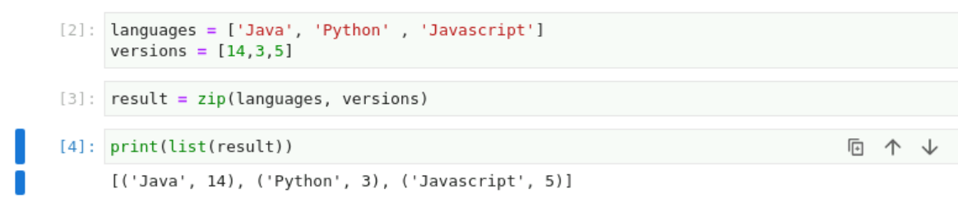
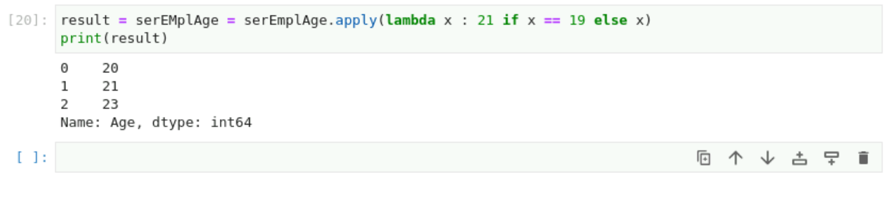
Day-24 (19th September 2023 ) Python
Zip function
Lambda

Slide 4
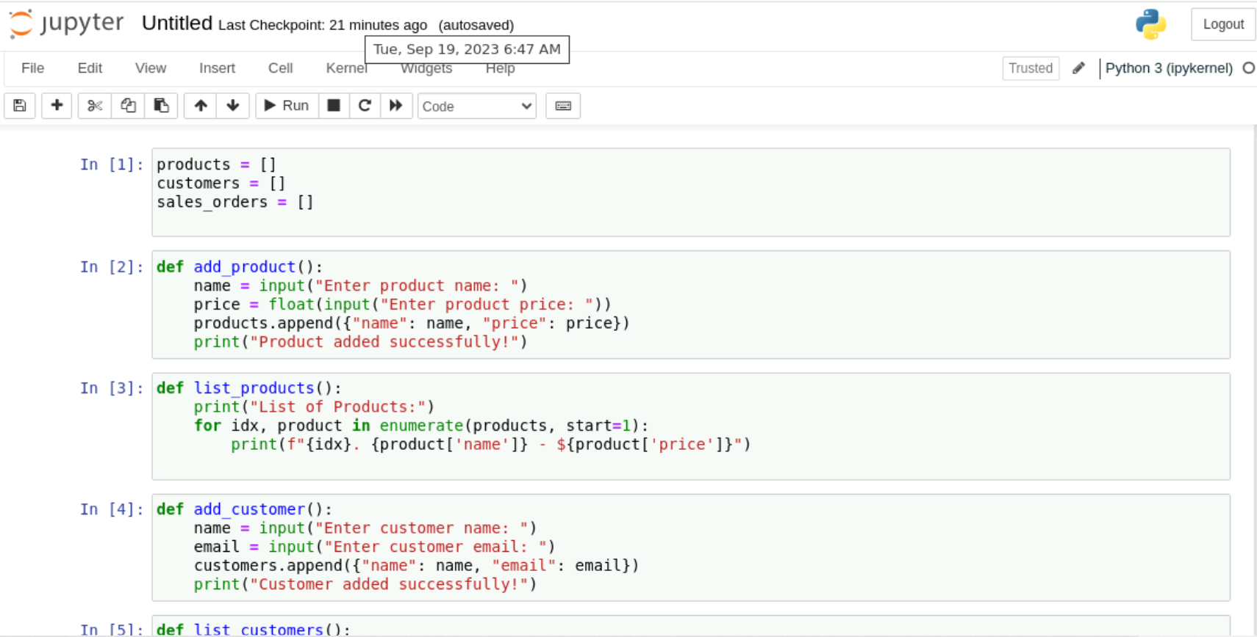

Slide 5
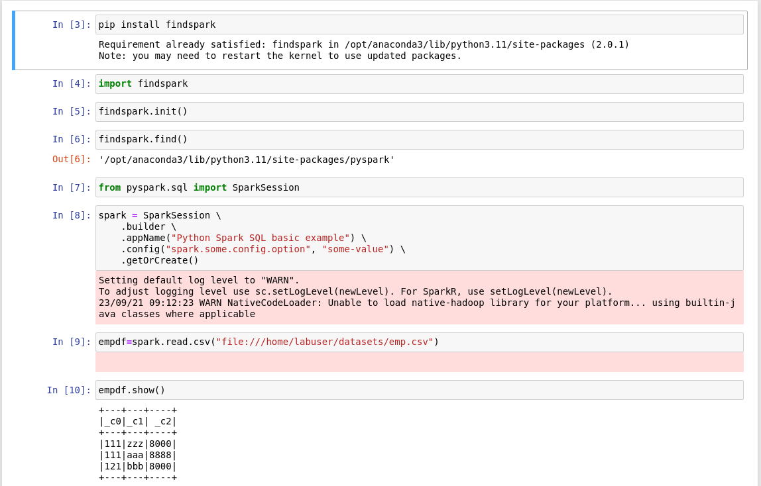
Day-25 (20th September 2023 ) Pyspark

Slide 6
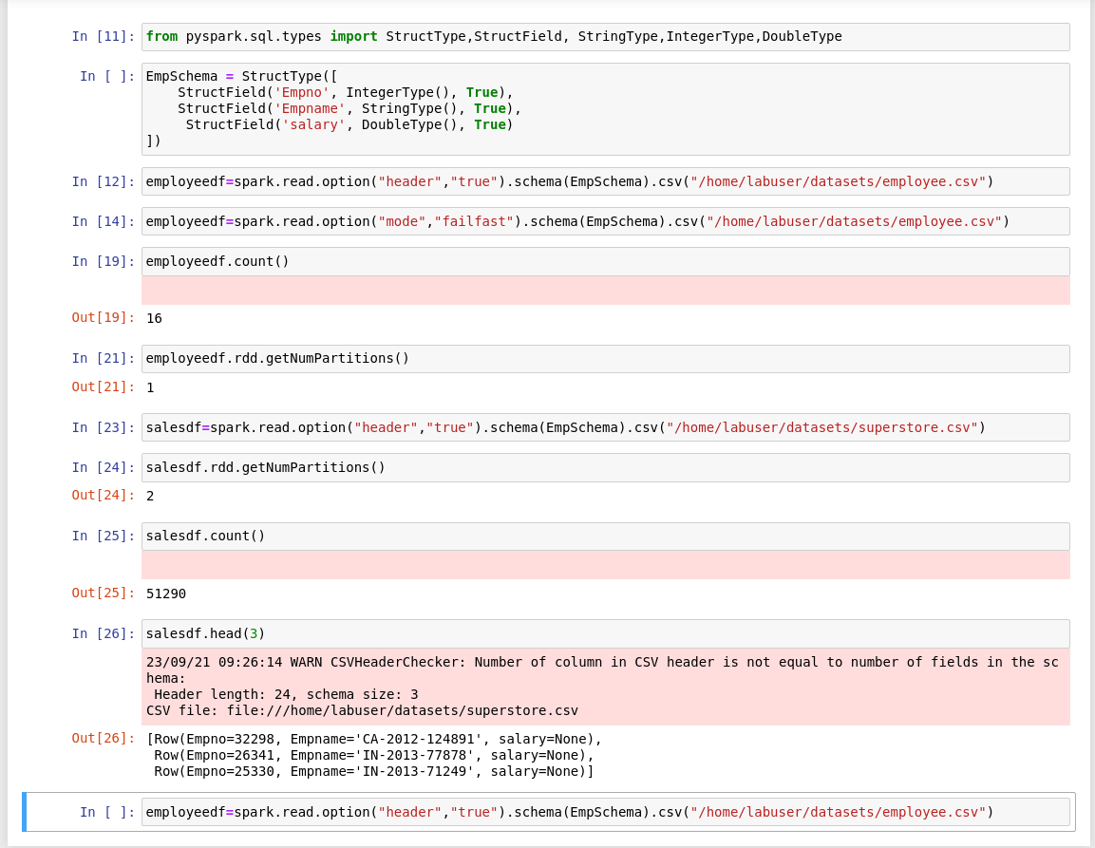

Slide 7
Day-26 (21st September 2023 )
Sick Leave

Slide 8
Day-27 (22nd September 2023 )
Sick Leave

